Slide 1
Progress Report 6
Sprint 6 - (3/19 - 3/26)
Brian Goughnour, Josh Brown, Steve Stamey, Guylain Kibunzi, Chauncey Davidson

Slide 2
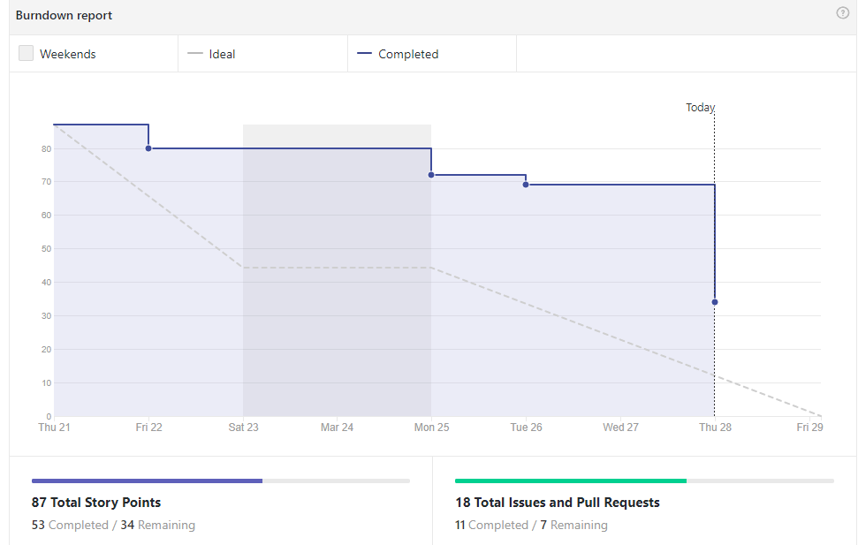
Burndown Report (Last Sprint)

Slide 3
Sprint Backlog - Responsibilities
Charles Stamey - Adding pages for settings options. App icon integration for Android/IPhone main screen(splash screens, outside app icons)
Guylain Kibunzi - Education/Resources pages. Menu navigation through the subsystem.
Joshua Brown - Added Bootstrap to Main menu and Calendar. Remade navbars. Added Calendar notifications to created event. User ability to edit existing events. Help with goal tracker integration
Brian Goughnour - Goal tracker integration into main project. Storing events inside the database table.
Chauncey Davidson - Implement Map Events, implement local database for other subsystems (if needed), assist with Information (if not finished)

Slide 4
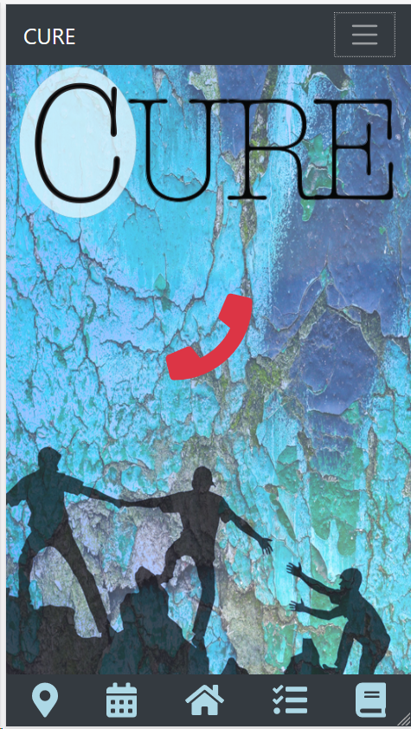
Bootstrap Update

Slide 5
Goal Tracker (Progress)
Rewrote the subsection in Blaze
Added the Goal Tracker into the main system
Forgot “enter keys” don’t exist on phones. So added a button.

Slide 6
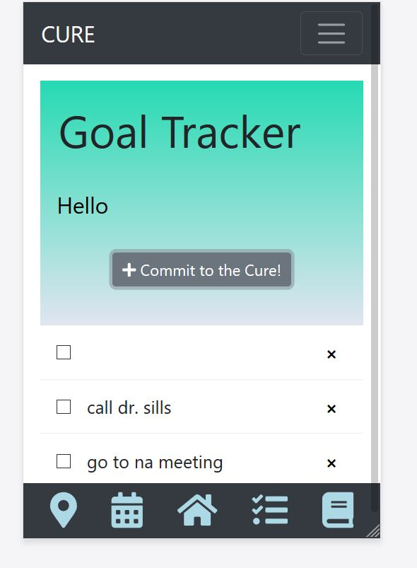
Goal Tracker (Progress Continued...)

Slide 7
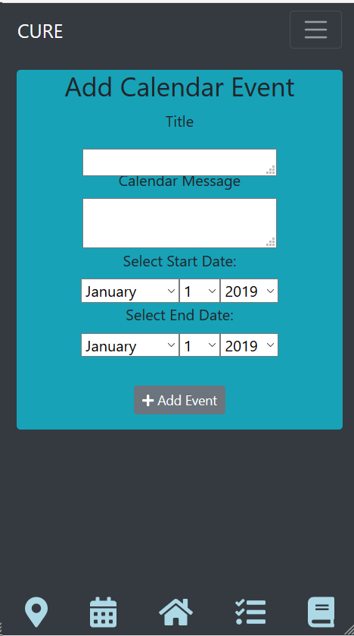
Calendar Updates
Cleaner UI
Notifications are now added
Existing events can be modified

Slide 8
Future Sprint
Final touches on Calendar.
Further UI cleaning
Documentation/graphs for Calendar
Passing Calendar data to goal tracker.
Education/Information section
Adding a predetermined list for the 5 Steps to Harm Reduction to Goal Tracker.
Repair button for Goal Tracker.

Slide 9
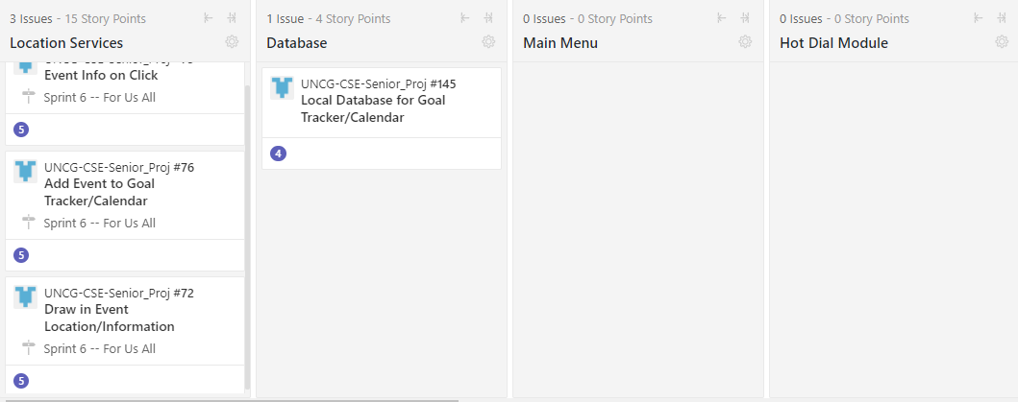
ZENHUB

Slide 10
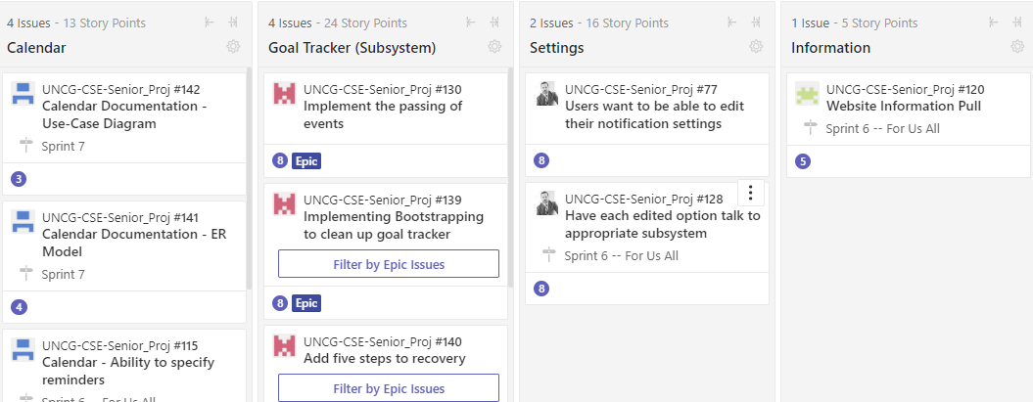
ZENHUB

